Slide 1
CxO Amplify
AI Readiness Diagnostic
Prepared for:
Matt Christensen, CIO
XYZ Organization · May 2026
YOUR ARCHETYPE
The Quiet Performer
Governance structures exist on paper but nobody owns anything
CxO Amplify

Slide 2
IMPORTANT NOTICE
VERDICT: NOT READY TO LAUNCH
Sample Report - 13 of 28 pages.
Full report delivered upon engagement completion.

Slide 3
Your Diagnosis
The Quiet Performer
Real AI value being created. The organization does not yet know what it is worth.
AI ARCHETYPE
PRIMARY CONSTRAINT
SECONDARY DRAG
The Quiet Performer
AI Value Realization
Data & Operational Readiness
real value · invisible return
score 6/16 · fix this first
score 7/16 · uneven foundation
Fix this first. Everything else compounds.
AI Value Realization: 6/16
If nothing changes
Leadership defaults to cost-reduction logic when AI ROI cannot be demonstrated
Shadow AI grows as business units fill the perceived gap with ungoverned tools
The board asks for AI evidence — before the measurement infrastructure exists to provide it
Amplify

Slide 4
The Seven AI Archetypes
Every diagnostic produces one of seven profiles. Each describes a distinct pattern — different constraint, different intervention. Yours is highlighted.
The AI Tourist
The Data Mirage
Experimenting everywhere, operationalizing nowhere
Advanced AI ambitions the data foundation cannot support
The Pilot Factory
● YOUR ARCHETYPE
The Quiet Performer
Disciplined experiments that never survive contact with the operating model
Real AI value being created. Almost nobody knows it.
The Shadow Accelerator
The Strategic Amplifier
AI spreading faster than governance can follow
AI connected directly to operational and strategic leverage
The Automation Mirage
Transformation ambition without the process discipline to deliver it
High organizational risk
Moderate risk / opportunity cost
Building capability / protecting value
CxO Amplify

Slide 5
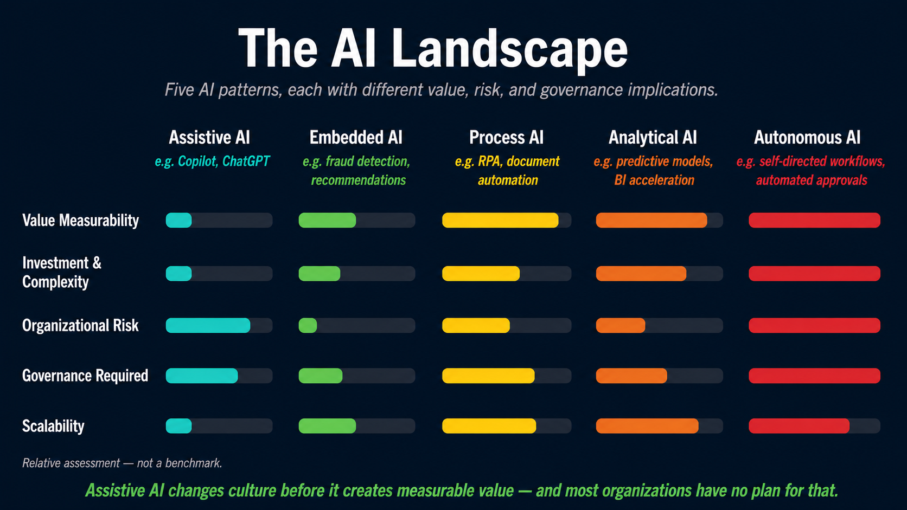

Slide 6
AI Type Readiness Map
Not which AI to pursue — which AI your current organizational readiness can support without significant risk.
AI Type
Readiness
Limiting Factor & Advisory Note
Assistive AI
PROCEED WITH CAUTION
Workforce capability sufficient. Governance needs strengthening before scaling — data exposure and shadow AI risk. Readiness does not equal priority: confirm value case before expanding.
Copilot, ChatGPT
Embedded AI
HIGH READINESS
Lowest organizational risk. Current readiness supports deployment. Vendor-embedded AI governance needs documentation. Just because you can does not mean you should — validate the value case first.
Fraud detection, recommendations
Process AI
CAUTION
Process documentation and consistency gaps will limit reliability at scale. Requires standardization in targeted areas before deployment — automating inconsistent processes produces inconsistent outcomes.
RPA, document automation
Analytical AI
PREMATURE
Data quality and trust gaps are the primary blocker. Data readiness is the prerequisite — not a parallel workstream. Attempting Analytical AI before this is resolved produces expensive pilots that cannot scale.
Predictive models, BI
Autonomous AI
PREMATURE
Governance, accountability frameworks, and data readiness are all insufficient. Attempting deployment at current readiness creates accountability gaps that are very difficult to close retroactively.
Self-directed workflows
CxO Amplify
Readiness indicates organizational capacity — not strategic priority. High readiness for a low-value AI type is not a reason to invest. Validate the value case first.

Slide 7
Where You Stand: AI Ambition vs. Organizational Readiness
The most common AI failure is not lack of ambition — it is ambition that outpaces the organization's ability to deliver.
Low
High →
ORGANIZATIONAL READINESS
↑ High
Underleveraged Capability
Strategic Amplifier
Readiness exists. Appetite has not caught up. The organization is leaving value on the table.
Ambition and readiness are matched. AI is connected to leverage. Target state.
AI AMBITION
Value Black Hole
● YOU ARE HERE
Mismatched Momentum
High AI ambition, low organizational readiness. Activity without return. The most dangerous quadrant.
Moderate readiness — but value is invisible to leadership. This is where XYZ Organization sits today.
Low ↓
CxO Amplify

Slide 8
What These Four Maps Tell You Together
The pattern across all four maps is consistent. Together they confirm the primary finding.
AI Ambition vs Readiness
AI Value Visibility vs Activity
Quiet Performer
Quiet Performer
Moderate readiness sitting below AI ambition. The gap is real and closing it requires sequencing, not speed.
Real AI activity producing real value — but leadership cannot see it. This is the primary constraint.
Governance vs Innovation
Executive Commitment vs Workforce
Stalled Bureaucracy
Orphaned Initiative
Governance is not yet enabling velocity. AI decisions are slow to make and slower to enforce.
Workforce capability exists. Executive commitment is inconsistent. AI is an IT initiative, not an organizational one.
Across all four maps, the pattern is identical: strong capability, insufficient visibility and organizational support. This is not four problems. It is one constraint showing up in four different ways.
CxO Amplify

Slide 9
Diagnostic Scorecard — All Six Dimensions
Red = primary constraint. Amber = secondary drag. All others performing at or above threshold for the current mandate.
Dimension
Score
Relative Strength
Status
AI Strategic Clarity & Prioritization
8/16
—
AI Governance & Decision Discipline
9/16
—
Data & Operational Readiness
7/16
▲ secondary drag
Workforce & Change Readiness
10/16
—
AI Value Realization
6/16
▲ primary constraint
Executive & Board Commitment
8/16
—
The goal is not maximum AI sophistication. The goal is the minimum AI complexity required to create durable business value.
CxO Amplify

Slide 10
Focus Area 1 — AI Value Realization
The primary constraint. Fix this first. Everything else compounds.
OBSERVED BEHAVIORAL GAPS: THE QUIET PERFORMER PATTERN
· AI activity is visible. AI value is not. You can describe what is deployed — you cannot easily describe what it produced last quarter.
· Budget conversations about AI default to cost because nobody has built the framework to talk about return.
· Your strongest AI win exists as a story, not a metric. The story is accurate. It does not scale to a board conversation.
· Finance sees AI as an expense category. That classification will not change until you change the conversation.
THE FIRST MOVE
WHAT GOOD LOOKS LIKE
MOST COMMON FIRST ATTEMPT MISTAKE
Build an AI Value Summary for your top three active deployments — what was invested, what changed, what the organization can now do.
Share with leadership unprompted. Not a formal report — a confident brief.
Do this monthly. Within two quarters, the conversation shifts.
"We deployed Copilot in Q1. Proposal turnaround dropped from 4 days to 1.5. The sales team closed three deals previously lost to timeline. That is what AI produced last quarter."
Four sentences. No jargon. That is a value report.
Reporting what AI did instead of what the organization got for it.
"Deployed Copilot to 200 users" is an activity. "Proposal cycle reduced by 60%" is a return.
Leadership funds returns, not activities.
CxO Amplify

Slide 11
The 12-Month Roadmap
Sequenced, not parallel. Fix the constraint first. Each move creates the conditions for the next.
First 90 Days
Months 4–6
Months 7–12
Fix the constraint
Reinforce and connect
Move the organization
Build AI Value Summary for top three active deployments — outcomes, not activities. Share with leadership unprompted.
Value Summary becomes standing monthly leadership communication rhythm.
AI Value Realization moves from primary constraint to managed dimension.
Establish outcome metrics for top three AI deployments before next investment request. Measurement built in, not retrofitted.
Outcome metrics feeding into AI portfolio review — evidence-based prioritization.
Data & Operational Readiness program active in business units targeted for Analytical AI.
Bring AI Type Readiness Map to CEO. Name which AI types are ready, which require investment, which are premature. Ask for a specific budget decision.
CFO conversation: separate exploration budget from scaling budget. Name the trade-off explicitly.
The Quiet Performer, with measurement infrastructure in place, is positioned to become the Strategic Amplifier.
Audit vendor-embedded AI across major SaaS platforms. Document governance gaps. Shadow Accelerator risk prevention.
Governance framework extended to cover all vendor-embedded AI. Not a policy — a practice.
Reassess all six dimensions. Identify the next constraint. Repeat.
CxO Amplify
The first Value Summary. The first outcome metric. The first executive conversation. Those are the opening moves. The rest we build from there.

Slide 12
CxO Amplify · AI Readiness Diagnostic
There is one decision this report asks you to make:
Will you build the measurement infrastructure before the board asks for it — or after?
The gap is real. The path is clear. The moves are specific.
If the findings in this report resonate — and if you are unsure how to act on them, too deep in the day-to-day to drive the change, or simply unwilling to let another budget cycle pass without making AI's value visible — that is exactly what CxO Amplify is built for.
I do not traffic in frameworks. I help turn ambiguity into forward motion.
If you would like to discuss what closing these gaps looks like in practice — reach out directly.
Michael O'Brien · michael@cxoamplify.com · 703.629.4332 · cxoamplify.com
There is no pitch. The first conversation is a conversation.
CxO Amplify

Slide 13
Assessment Design and Scoring Logic
Appendix
01 Question Design — Behavioral Anchoring
The 24 assessment questions are structured around observable organizational behaviors rather than capability self-assessments. Instead of asking "How strategic is your AI?" the diagnostic asks what happens in practice — how investment decisions are actually made, what occurs when a senior stakeholder challenges an AI initiative, how governance works under pressure. The primary constraint finding emerges from the pattern of behavioral responses — grounded in what the organization does, not what it intends.
02 Scoring Logic — Theory of Constraints Application
Each of the six dimensions is scored independently (4-16 scale, four questions per dimension). The primary constraint is identified not simply as the lowest absolute score, but as the dimension whose score, relative to the other dimensions in the profile, creates the greatest downstream drag on AI value realization. A dimension at 7/16 in a profile where everything else is 8-10 is secondary drag. A dimension at 6/16 in the same profile is a structural bottleneck.
03 Archetype Assignment
Archetypes are assigned by the pattern of dimension scores, not the total score. The same aggregate score can produce different archetypes depending on which dimensions are high and which are low. The Quiet Performer is characterized by moderate-to-high execution dimension scores combined with a low AI Value Realization score. The Strategic Amplifier shares similar execution scores but with a strong Value Realization dimension.
04 What This Assessment Does Not Claim
This assessment identifies the most likely constraint based on behavioral responses across six dimensions. It does not account for every organizational variable — political dynamics, individual personalities, board composition, market conditions. The constraint finding is a strong hypothesis, not a verdict. The value of the engagement that follows is in testing that hypothesis against the specific context — and adjusting the sequence if the hypothesis turns out to be wrong. Most of the time it is not wrong. When it is, naming that is part of the work.
CxO Amplify

